Slide 1


Get Started Saving Money Today!
The Smart and Easy Way to Save

Slide 2

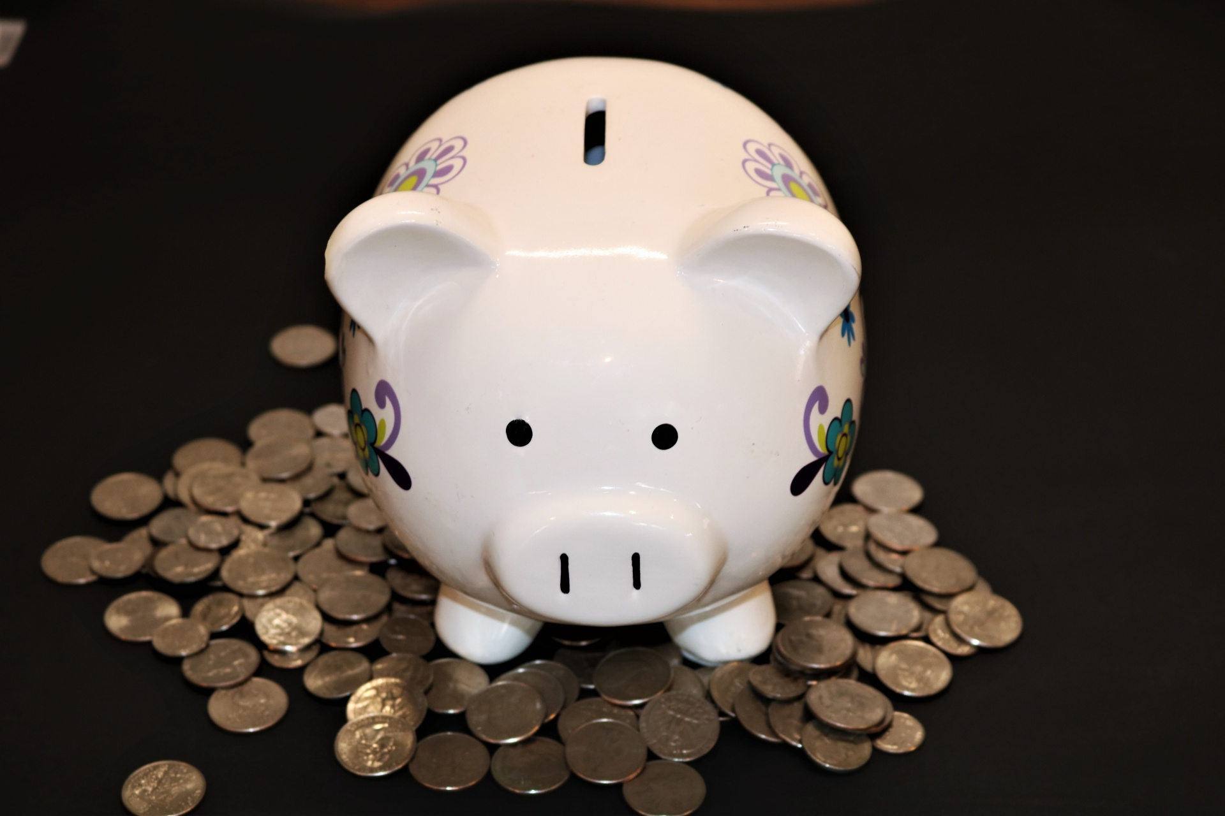
Set Goals
Set specific goals
Set amount for each savings goal
Set a timeline
Create a plan
Get into the right mindset

Slide 3
Create a Budget
Create a template in Excel
Create categories that work
Note your net income
Track your spending
Adjust your spending habits

Slide 4
Monthly Expenses
Expense | Budget
Rent | $750
Utilities | $225
Credit Cards | $90
Groceries | $315
Entertainment | $125

Slide 5
Where Can You Decrease Spending?
Retail savings cards
Online deals (subscriptions)
Shop for sales and discounts
Cook at home
Clip coupons
Do free activities (hiking, fishing, game night, etc.,)
Disconnect electronics
Bring your lunch

Slide 6
Where Can You Increase Income?
Part-time job
Dog walking or lawn mowing service
Freelancing jobs
Sell items on Craig’s List or E-Bay
Collect cans or bottles
Turn a hobby into a business

Slide 7
Negotiate Better Interest Rates
Know your FICO score
Consolidate credit cards (and make a plan to pay them off!)
Shop around for best high interest savings account

Slide 8
Tax Advantages
Retirement account
Contribute to company FSA
Pre-tax transportation benefits
Itemize on tax return
Pay off debt with tax return

Slide 9
Technology is Your Financial Friend
Online personal finance services
Online banking (real time account balances)
Online bill pay (avoid those late fees)
Track spending through credit card Web sites
Download financial apps on your phone
Sign up for automatic direct deposit to your savings account

Slide 10
The first steps in my savings commitment:
Create my budget
Consolidate debt
Save 10% of every paycheck
Stop using my credit card
Stick to my plan

